Slide 1
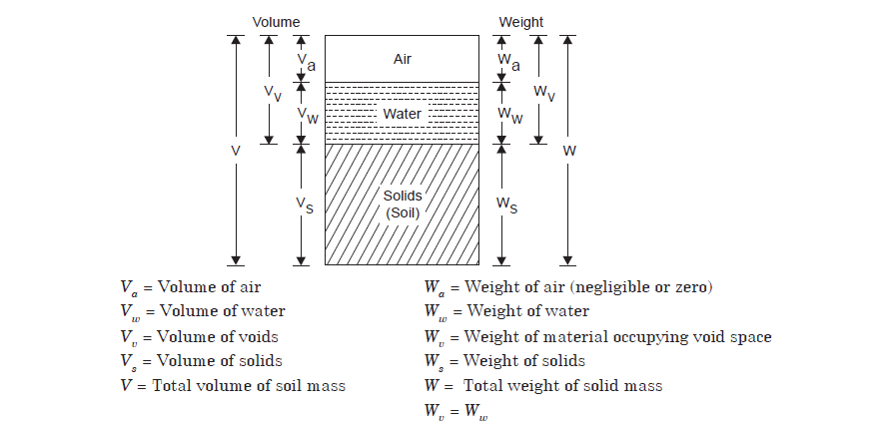
TWO MARK QUESTIONS AND ANSWERS:
1.Draw the phase diagram of the soil.

Slide 2
2. What Is Void Ratio? (e)
3. What is Porosity? (n)
4. Degree of saturation: Define (Sr)

Slide 3
5. Define percentage of air voids .
6. Define air content: Define.
7.Define: Water Content (w)
1.

Slide 5
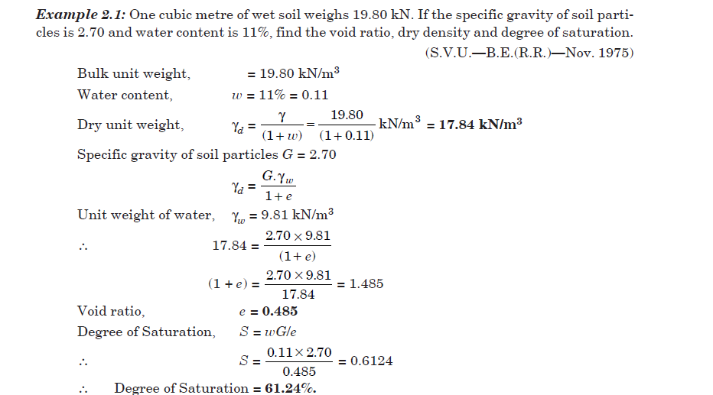

Slide 6
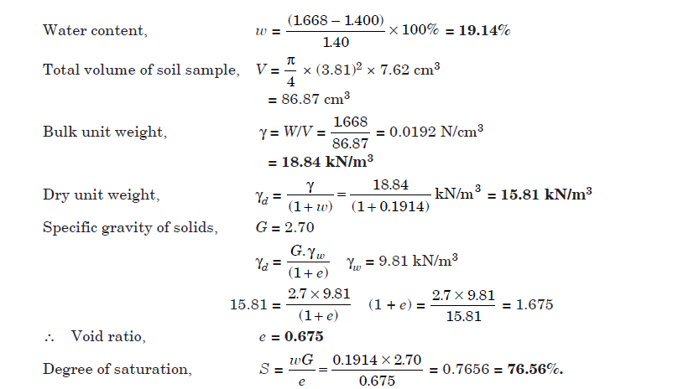

Slide 7
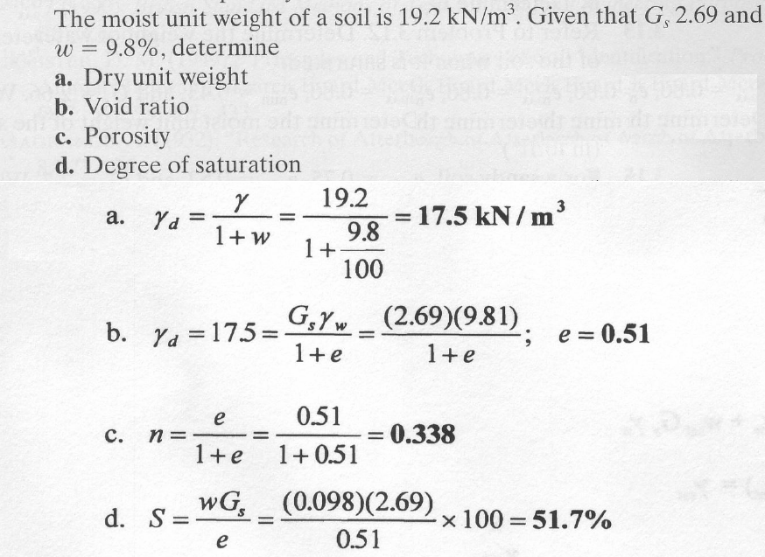

Slide 8
13 .Define: Density Index ( ID) or Relative Compactive
The density index is defined as the ratio of the differences between the voids ratio of the soil in the loosest state and its natural voids ratio & to the differences between voids ratio in the loosest and densest states.
14. What is compaction?
Compaction is a process by which the soil particles are artificially rearranged and packed together into a closer strata of contact by mechanical means in order to decrease the porosity ( or voids ratio) of the soil and thus increase its dry density

Slide 9
15. Aim of the compaction
i) To increase the shear strength soil
ii) To improve stability and bearing capacity
iii) To reduce the compressibility
iv) To reduce the permeability of the soil.
16. What are the methods available for sieve analysis?
a) Dry sieve Analysis
b) Wet sieve analysis
17. Atterberg limits: define
The limit at which the soil, changes from one state to another state, is termed as atterberg limits.
18. Liquid limit: define
Is the water content at which the soil, changes from liquid to plastic state liquid.
19. What is plastic limit?
The maximum water content at which, soil changes from plastic to semi-solid state.
20. Define: percentage of air voids (na)
Percentage of air voids is defined as the ratio of the volume of air voids to the total volume of soil mass.

Slide 10
16 MARKS QUESTIONS AND ANSWERS
1. A soil sample has a porosity of 40% .the specific gravity of solids 2.70,
Calculate
(a) void ratio
(b) Dry density
(c) Unit weight if the soil is 50% saturated
(d) Unit weight if the soil is completely saturated.
Solution
2.An undisturbed sample of soil has a volume of 100 cm3 and mass of 190.g. On oven drying for 24 hrs, the mass is reduced to 160 g. If the specific gravity grain is 2.68, determine the water content, voids ratio and degree of saturation of the soil.
solution

Slide 11
3. Explain the BIS classification for soil system
Indian standard classification (ISC) system adopted by Bureau of Indian Standards is in
many aspects.
Soils are divided onto three broad divisions
(i) Coarse-grained soils, when 50% or more of the total material by weight is retained on 75 μ IS Sieve
(ii) Fine – grained soils, when more then 50% of the total material passes 75μ IS sieve
(iii) If the soil is highly organic and contains a large percentage of organic matter and
particles of decomposed vegetation, it is kept in a separate category marked as peat.
1. Coarse – grained soils.
Coarse – grained soils are subdivided into gravel and sand. The soil is termed
gravel and sand. The soil is termed gravel (G) where more than 50% Coarse
fraction (plus 75 μ) is retained on 4.75mm IS sieve ,and termed sand (s) if more
than 50 % of the coarse friction is smaller than 4.75 mm IS sieve.
2. Fine Grained
Fine – grained soils are further divided into three subdivisions, depending upon
the values of the liquid limit.
a) Silts and clays of low compressibility – liquid limit less than 35
(Represented by symbol H)
b) Silts and clays of medium compressibility- these soils have liquid limit
greater than 35 but less than 50.
c) Silts and clays of high compressibility- these soils have liquid limit
greater than 50(Represented by symbol H).

Slide 12
consolidation and compaction
4. Different between consolidation and compaction
CONSOLIDATION
COMPACTION
It is a gradual process of reduction of volume under sustained, static loading.
It causes a reduction in volume of a saturated soil due to squeezing out of water from the soil.
Is a process which in nature when saturated soil deposits are subjected to static loads caused by the weight of the building
It is a rapid of reduction of volume mechanical mean such as rolling , tamping , vibration.
In compaction, the volume of partially saturated soil decreases of air the voids at the unaltered water content.
Is an artificial process which is done to increase the density of the soil to improve its properties before it is put to any use.

Slide 13
5. What are the factors affecting compaction? Explain in brief?
i) Water content
a) At lower water content, the soil is stiff and others more resistance to
compaction.
b) As water content is increases, the soil particles get lubricated.
c) Dry density of the soil increases with increases in the water content till the
optimum water content is reached.
d) After the optimum water content is reached, it becomes more difficult to force air out and to further reduce the air voids.
ii) Amount of compaction
At water content less than the optimum, the effect of increased compaction is
more predominant. At water content more than optimum, the volume of air voids becomes almost constant and the effect of increased compaction is of significant.
iii) Type of soil
In general, coarse – grained soils can be compacted to higher dry density than fine grained soils. With the addition of even a small quantity of fines to a coarse grained soil, the soil attains a much higher dry density for the same compactive effort. Cohesive soils have air voids .Heavy clays of very high plasticity have very low dry density and very high optimum water content.

Slide 14
iv) Method of compaction
The dry density achieved depends not only upon the amount of compactive effort;
the dry density will depend upon whether the method of compaction utilizes
kneading action, dynamic or static action.
v)Admixture
The compaction characteristic of the soils is improved by adding other materials
known as admixtures. Ex; lime, cement and bitumen
6.What are the different methods of compaction adopted in the field?
i) Tampers.
A hand operated tamper consists of block iron, about 3 to 5 Kg o mass,
attached to a wooden rod. The tamper is lifted for about 0.30m and dropped on the soil to be
compressed. Mechanical Tampers operated by compressed air or gasoline power.

Slide 15
ii) Rollers
a) smooth – wheel rollers
b) pneumatic – tyred rollers
c) Sheep- foot rollers.
a) smooth – wheel rollers
Smooth – wheel rollers are useful finishing operations after compaction of
fillers and for compacting granular base causes of highways.
b) Pnumatic – tyred rollers
Pneumatic – tyred rollers use compressed air to develop the required inflation pressure.
The roller compactive the soil primarily by kneading action. These rollesrs
are effecting for compacting cohesive as well as cohesion less soils.
c) Sheep – foot rollers
The sheep – foot roller consists of a hollow drum with a large number of small projections (known as feet) on its surface. The drums are mounted on a steel frame. The drum can fill with water or ballast increases the mass. The contact pressure is generally between 700 to 4200 KN/m2.

